Slide 1

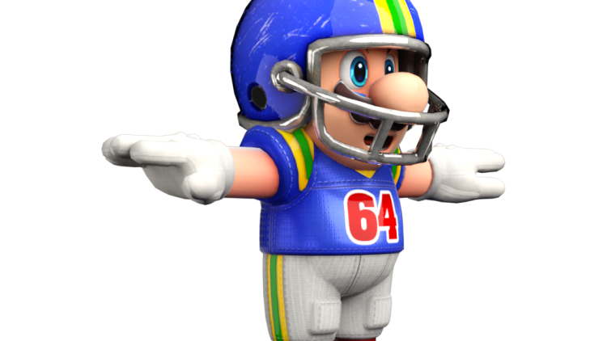

Football VII
Produced by Dr. Mario | UNC STOR 390

Slide 2
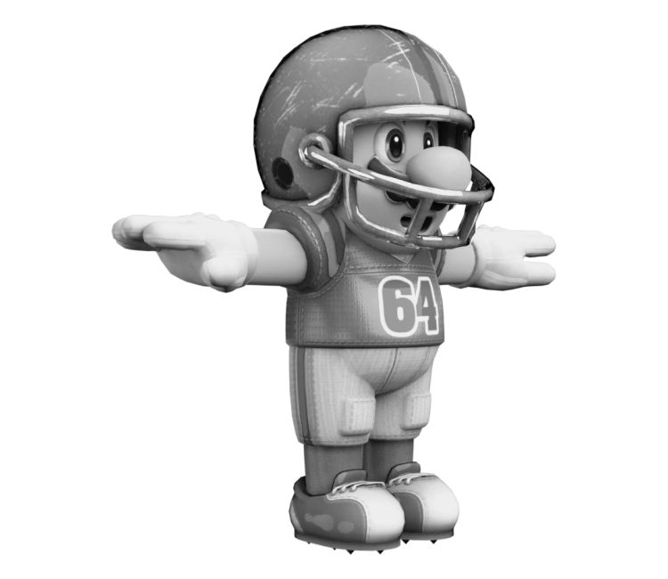
Flaws of NFL Overtime
NFL Overtime
Occurs in the Situation of a Tied Game
Coin Toss Winner Has Two Choices
Choice 1: Kickoff
Choice 2: Receive
Overtime is Sudden Death
If No Team Wins in Overtime, Game Results in a Tie
Receiving Team Wins 60% of the Time (1994-2006)
Proposed Moving Kickoff to Make it Harder for Receiving Team
It is better to receive, than to give.
- Mahatma Mario

Slide 3
Flaws of NFL Overtime
Mathematical Model of Sudden Death Overtime
Let p = Probability Average NFL Team Scores in a Possession
Assumption: Each Team Has Identical Probability of Scoring
Ties Happen Less Than 5% of the Time
Assumption: Game Will Endure Forever
Let K = Probability Team Receiving Wins the Game
Two Ways Receiving Team Wins
Receiving Team Scores on First Possessions
Receiving Team Fails to Score But Scores on Later Possession
$$P\left(Win on First Possession\right)=p$$
$$P\left(Win on Second Possession\right)=\left(1−p\right)\left(1−p\right)K$$
Assume Independence

Slide 4
Flaws of NFL Overtime
Based on Previous Statements
How Would the NFL Make Overtime Fair?
$$K=p+\left(1−p\right)\left(1−p\right)K$$
Is This Nonsense?
$$K=\frac{p}{1−(1−p)(1−p)}=\frac{p}{2p−p^{2}}=\frac{p}{p(−p+2)}=\frac{1}{2−p}$$
Must Be Greater Than 50%

Slide 5

Flaws of NFL Overtime
Checking Mathematics Empirically
Using NFL Data (2003-2006)
Therefore, the Probability Receiving Team Wins in Overtime
Changing the Rules
In 2012, NFL Modified Overtime Rules
Receiving Team Needs a Touchdown to Win the Game
Since then 52.7% of Coin Toss Winners, Win the Game
$$p=31\%$$
$$K=\frac{1}{2−0.31}=0.59≈60\%$$

Slide 6


Flaws of NFL Overtime
Modified Mathematics
Let p = Probability Average NFL Team Scores in a Possession
Let q = Probability Average NFL Team Scores a Touchdown in a Possession
Probability Receiving Team Wins on First Possession
Probability Receiving Team Wins on Second Possession
Now, Based on Mathematics
Based on 2019, q = 22.4% and p = 36.4%
$$P\left(Win on First Possession\right)=q$$
$$P\left(Win on Second Possession\right)=\left(1−q\right)(1−p)K$$
$$K=q+\left(1−q\right)(1−p)K$$
$$K=\frac{q}{1−(1−q)(1−p)}$$
$$K=\frac{0.224}{1−(1−0.224)(1−0.364)}=44.23\%$$
Math is Dope

Slide 7
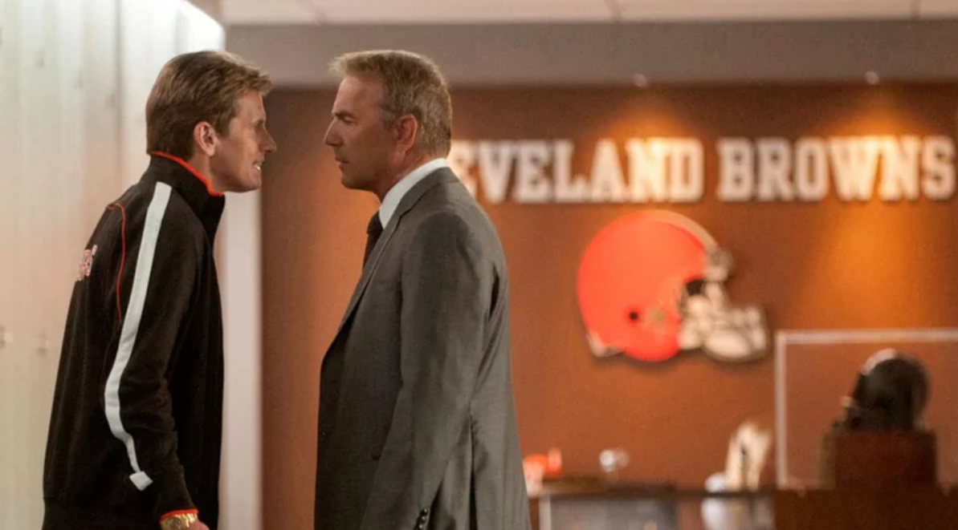
Value of High Draft Picks in NFL

Slide 8
Value of High Draft Picks in NFL
Impact of the NFL Draft
NFL is Considered to Be the Fairest League in the Land
Teams Draft in Inverse Order From Browns to Best
There are 8 Rounds in the NFL Draft
6.1 Million People Watch on Average
100,000 People Attend on Average
Early Draft Picks are Believed to Be More Valuable Than Late Draft Picks
Research by Cade Massey and Richard Thaler
Article Called The Loser’s Curse
Collected Data on All Draft Day Trades From Recent Years
Define v(n) = Value of the nth Pick
Not About the Player But About the Position
Suppose Team Traded 12th and 28th Pick for 4th Pick
$$v\left(12\right)+v\left(28\right)=v(4)$$

Slide 9
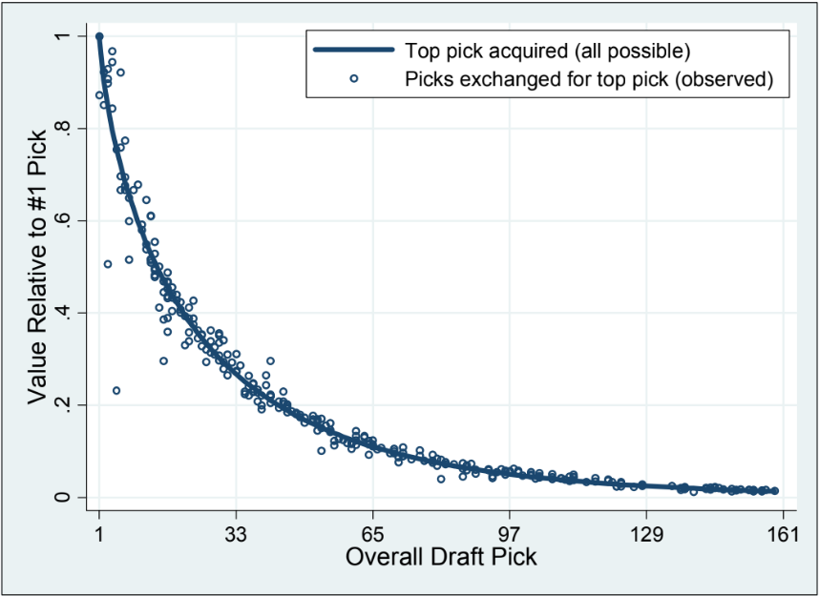
Value of High Draft Picks in NFL
Model for Value
Used Exponential Function
Based on Weibull Distribution
Estimated Parameters a and b Based on Data From Trades
Trades Can Be Used to Identify the Perceived Value of the Picks
Final Estimates: a = -0.148 & b=0.7
$$v\left(n\right)=e^{−a{\left(n−1\right)}^{b}}$$

Slide 10
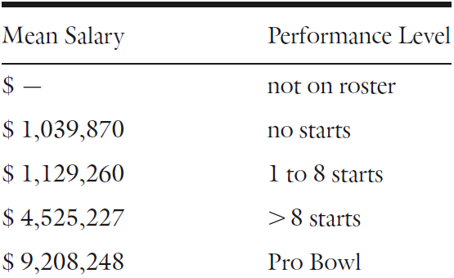
Value of High Draft Picks in NFL
Determining Value of Player According to On-Field Impact
Not on Roster
No Starts
1-8 Starts
9-16 Starts
Pro-Baller
Determining Value of Player According to Salary
Salary of Quarterbacks

Slide 11
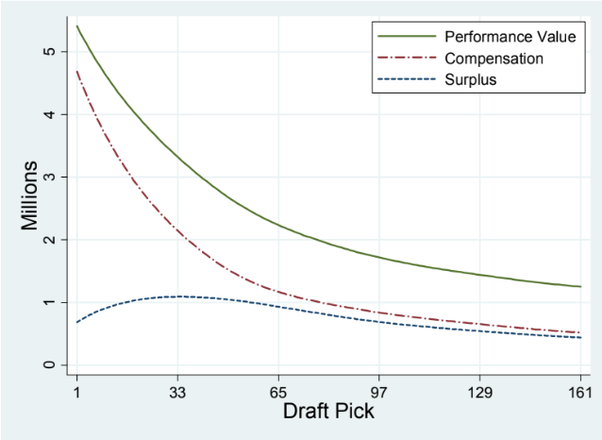
Value of High Draft Picks in NFL
Examination of Surplus
Drafted NFL Players are Paid According to Draft Position
Determined By Player Value Minus Average Player Salary
Discovered Average Surplus By Draft Position Increased
Meaning Later Picks Contributed More Value

Slide 12
Value of High Draft Picks in NFL
Critique’s by Phil Birnbaum
Well-known in Sabermetrics
Major Flaw: Assumption Players Who Play the Same Position and Are in the
Same Performance Category are Equally Valuable
Example: Quarterback with 1 Game Equivalent to QB with 8 Games
Need Better Measure of Player Performance Than Usage in Starts
Using Combine 40-YD Dash to Predict Running Back Performance
Important to Identify Good Draft Picks
Analysis Done by Bill Barnwell
40-YD Dash Time Negatively Correlated With YDs Gained and Carries (-0.36)
When Would a Slower Runner Be Better Than Faster Runner?

Slide 13
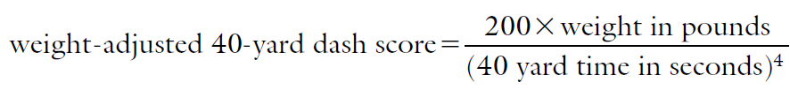
Value of High Draft Picks in NFL
Adjustment for Weight
Thanks Bill Barnwell
New Measure Has a 0.45 Correlation with Yards and Carries
Accounts for Data from 1999 to 2008
Calibrated to Average Out to 100 Across All Running Backs
Any Other Criticism’s of Value Model by Massey and Thaler?

Slide 14
Value of High Draft Picks in NFL
The Winner’s Curse
Look for Reasons of the Draft’s Inefficiency
Winner’s of Auctions Pay More Than the Object is Worth
Surplus Analysis Shows Picks Below #43 are at a Disadvantage
Because of Trades, Teams are Bidding on Picks
In What Other Ways are Winner’s Cursed?
If you’re not first, be last.
- Mahatma Mario

Slide 15
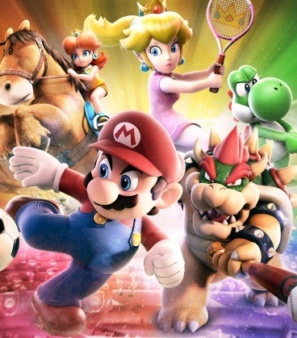
Final Inspiration
Life is just a competition
to see who dies the slowest.
- Mahatma Beja-Glasser

